Slide 1
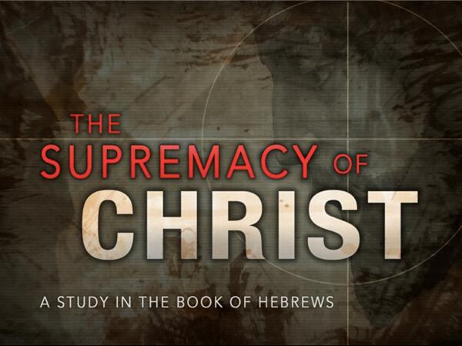

Slide 2
JESUS SUPERIOR TO THE ANGELS
HEBREWS 1:4-14

Slide 3
INTRODUCTION
Angel’s helped bring the O.L.
  Acts 7:53 “you who received the law as delivered by angels and did not keep it.”
  Gal. 3:19 “why then the law? It was added because of transgression, until the offspring should come to whom the promise had been made, and it was put in place through angels by an intermediary.”

Slide 4
INTRODUCTION
The angels helped bring the Law in the Old Testament, but Christ is better than the angels.
Verse 4 is clear “having become as much more superior to angels as the name he has inherited is more excellent than theirs.”
Christ is better because He is the SON.

Slide 5
JESUS IS THE SON
O.T. prophecies calling the Messiah “Son”
  Psalm 2:7
  2 Sam 7:14
No angel was ever called “My son”.
  This proves that Jesus was not a mere angel of the Lord God like the JW”s believe.

Slide 6
JESUS IS THE FIRSTBORN
Can mean the child born first to the father, or may mean the child who has the privileges of the inheritance.
  Describing Israel – Ex 4:22
  Describing David – Psalm 89:20, 27
  Describing Jesus – Col. 1:15-18

Slide 7
JESUS THE FIRSTBORN
When the firstborn (Messiah/Son) would come, the angels would worship Him.
  Quoted from Duet 32:43
  Angels, prophets, priests, and Apostles not worthy of worship.
    Rev. 22:8-9
    Acts 10:25-26
  Jesus received lots of worship
    Mt. 2:11; Mt 8:2; Mt 9:18; Mt 14:33; Mt 15:25; Mt 28:9, 17; Lk 24:52

Slide 8
JESUS IS GOD
The “Son” is called “God” Himself
Makes a distinction between “Son God” and Father God”
The Son God will reign over the everlasting Kingdom.
  Dan 2:44 and Dan 7:13-14
  An Angel said it has no end – Lk 1:33
  Paul and John both write of it – Col. 1:13; Rev. 1:9
  He was anointed by Mary.

Slide 9
JESUS IS LORD OF CREATION
He is the creator of the universe.
  John & Paul both write of it. Jn. 1:3; Col. 1:16-17, Heb. 1:2
He is eternal.
  The physical will perish, but not the spirit. 2 Pet. 3:10-12; Heb. 13:8
He is the above the angels.
  The angels can not say “sit at my right hand.”

Slide 10
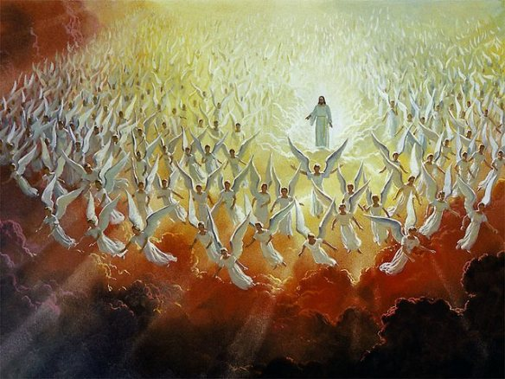
JESUS IS BETTER
The angels are servants and minsters to the Son. They worship the SON.
Jesus is the SON who sits at the right hand of God.
Jesus is the “firstborn” with its inheritance.
Jesus is a part of the Godhead.
Jesus helped create the world.

Slide 11
CLOSING
HEAR the word of God and BELIEVE that Jesus is the Messiah. CONFESS that you will follow and serve Him as your Lord. REPENT of the life of sin that He has set you free from and be BAPTIZED into Christ entering His Kingdom.

